Slide 1
ScienceWeek
Cranny NS 2020

Slide 2
Science Experiments
In some experiments you might have a hypothesis that you are testing (A statement you are trying to investigate)
List of equipment (anything you might need)
Procedure (step by step of how to carry out the experiment)
Predictions (what do you think might happen?)
Observations (make a note of what happened/ take photos for evidence)
Results (what happened?)
Conclusion (Why did this happen?)
Suggestions of what you might do differently next time

Slide 3
Investigating the Properties of Water
We will do 3 experiments to look at water and some interesting (and surprising) things about it
These are simple experiments to do and you can even try them at home

Slide 4
Experiment 1:
You will need:
Paper
Scissors
Colours
Shallow bowl of water

Slide 5
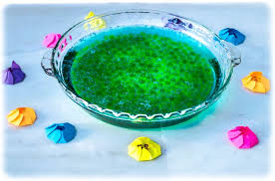
Draw some flowers. Use a round object for the centre and a lollipop stick or your finger for the petals.
Decorate it and then cut it out.
Fold in the petals.
Place in a shallow bowl of water.
What do you think will happen?

Slide 6
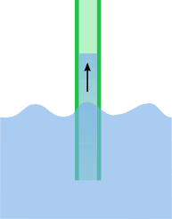
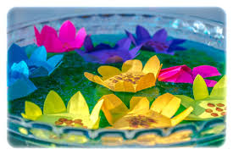
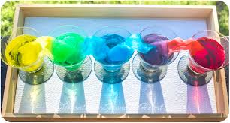
The water is drawn into the paper and starts to creep up the petals by something called capillary action.
The water softens and swells the tiny fibres that the paper is made of and this makes the petals open out.
Try this one at home:

Slide 7
Experiment 2:
You will need:
Paper, scissors and colours
Liquid soap
Tooth-picks
Shallow bowl of water

Slide 8
Make paper boats (5cm x 3cm rectangles) and cut a slit in them
Decorate your boat (get creative!)
Put your water in a basin/ tray, place the boat on the surface
Dip a tooth-pick in fairy liquid
Tip the surface in the slit of the boat gently
Watch what happens…..

Slide 9
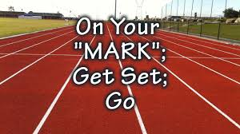
What could you change about this experiment.
Let’s have a race!

Slide 10
What happened?
The molecules of water stick together, particularly on the surface where they stick together tightly, like a skin. This is called surface tension.
When you sit the boat on top, it is light enough and the surface tension is tight enough that the boat can float.
When you add the soap it disrupts the surface tension a bit and can also create areas of a higher surface tension.
We created an area of lower surface tension behind the boat and higher surface tension in the front of the boat.

Slide 11
Experiment 3:
You will need:
Plastic bottle
Pin
Water
Tray

Slide 12
Pour water into a plastic bottle using a jug, over a shallow tray
Seal it with the cap
Using a pin make a hole at the side of the bottle
What do you think will happen when you take out the pin?

Slide 13
The water will not come out, unless you squeeze it!
Keep the bottle on the tray and open the cap.
What can you observe?

Slide 14
Even with the hole the water does not come out. Why?
Because it can’t! Unless something else goes in and takes up space in the bottle.
When we open the cap, air can go in to replace the water, so the water is free to leave the bottle through the hole.

Slide 15
Which experiment did you enjoy most?
How could you do these at home?

Slide 16
Well done!

